Slide 1
Performance appraisal

Slide 2
POLLING QUESTION?
DO YOU HAVE AN ANNUAL (at least) PERFORMANCE APPRAISAL SYSTEM?

Slide 3
Agenda
RATIONALE
FOUNDATIONS
PERFORMANCE MANAGEMENT SKILLS
    Social Justice Issues
    Collaboration
    Honesty
    Disciplinary Action vs. Performance Appraisal
    Common Errors
Ongoing Performance Management

Slide 4
PERFORMANCE REVIEWS
Every staff member has a right to a formal, written performance review
This is not a formal discipline or counseling session
Honesty is of great importance

Slide 5
COMMON questions
What do I need to have in place to do staff evaluation?
Communicating expectations to staff
Do, don’t do, and don’t even think about doing?
Form to use
Evaluating staff when things are going well
Evaluating staff when there are problems
Notes:
I am not sure if these are GR questions are Jim’s suggestions??

Slide 6
Why????
  Do we really need to do performance management?
Notes:
Who has a better or more important mission than we do?
Stewardship of all our resources is at the heart of this question.
Often the real question for pastors, is how do I see this as part of my “pastoral” resposibilities and not just my “employer” responsibilities.

Slide 7
Small group discussion
Have you tried doing performance appraisals?
  What has worked?
  What are the obstacles?

Slide 8
Effective Human Resources practices
Support and enable people who “do the mission.”
Enable us to achieve full realization of mission
Support the full realization of human potential of ministers, employees and volunteers
Enable us to serve the People of God and promote the Gospel

Slide 9
Foundations:
Definition of performance management:
  An organized strategy of monitoring work activities and their effectiveness
Planning issues: mission, vision, goals
  Establish performance review plan with staff well before the actual review
Communication
Conflict
Notes:
Mine for conflict
Regular, ongoing, steady communication; regula individual meetins with direct reports which must include ministerial staff

Slide 10
foundations
Probationary periods

Slide 11
Foundations:
Accountability
  Specific roles/positions
  General accountability for mission
  Excellence
  To self
  to colleagues
  To parishioners
Notes:
No silos; excelene vs no standards or expectations (Tell Placement Board story)

Slide 12
foundations
When implemented effectively, PA will have a positive impact on parish success and excellent implementation of mission and goals
Overall goal of Pa is to integrate the process into normal pastorayl and supervisory activity
Notes:
Give credit to the Diocese of Tucson

Slide 13
Can you be both pastoral and an employer?

Slide 14
Performance management skills

Slide 15

Social Justice

Slide 16
Social Justice Issues
Good diocesan policy requires that employees' performance be formally evaluated at least once per year.
Your perception of their performance will impact their future earnings and advancement opportunities.
Employees have a right to know your expectations regarding the content and quality of their work.
There should not be any surprises in connection with the employee’s performance evaluation.

Slide 17
Collaboration
Supervisor
Employee

Slide 18

Collaboration
Meet with the employee to review what he or she has and has not accomplished over the past year.
Keep an open mind to changing your evaluation.
Understand that yours is the final evaluation.
Understand that the employee has the right to submit a
written rebuttal and have it
attached to your appraisal when it
is placed in the employee’s file.

Slide 19
Collaboration
During the performance appraisal meeting, collaborate with the employee to establish reasonable and achievable development goals and performance objectives.
Review performance frequently, even if informally, during the course of the year.

Slide 20
Honesty
Needs Improvement
Exceeds Expectations
Meets Expectations
Exceeds Expectations
Improvement Needed
Exceeds Expectations
N/A

Slide 21
Honesty
Be clear about areas where the employee has not met your expectations and be prepared to give specific examples.
Give constructive criticism to encourage improvement in those areas where performance has not been satisfactory.
Give affirmation to reinforce those aspects of the employee's job he or she has handled well.

Slide 22
Honesty
Give credit where credit is due. Even a poor performer is likely to have performed some duties well.
Communicate expectations and priorities for which the employee will be accountable in clear and unambiguous terms.
You must cite on the performance appraisal form specific reasons and examples for ratings of “needs improvement” and “exceeds expectations.”

Slide 23
Honesty
Neither the employer's nor the employee's interests are served by glossing over shortcomings.
If we continue to tell poor performers that they are meeting or exceeding our expectations, we are reinforcing their poor performance and it is likely to continue.
If we continue to tell poor performers that they are meeting or exceeding our expectations, they will come to have an unrealistic perception of their strengths and abilities.

Slide 24
Disciplinary Action vs.
Performance Appraisal
Developmental Not Disciplinary
Not time to discuss disciplinary actions
Actions only taken if improvement not made in time frame
Coach, Do Not Reprimand
Criticism must be presented constructively
Criticism should be non-threatening
Clarify
Specify immediate remedial expectations
Offer encouragement and allow time to assess progress
Notes:
Supervisor awareness necessary—Be aware of daily work. Documentation on an ongoing basis.
Deviciencies may be included in formal process.

Slide 25
Ongoing Performance Management
Observe
Record
Give Feedback
Adjust Goals
Coach
Motivate
Encourage

Slide 26

Common Errors
Similar to me fallacy – Rating someone higher because they seem similar to you.

Slide 27

Common Errors
Contrast Effect – Comparing the employee to other employees rather than to objective standards for the job.

Slide 28
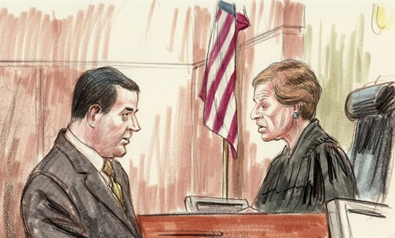
Common Errors
Leniency – Assigning inaccurately high ratings to all employees.

Slide 29

Common Errors
Strictness – Holding employees to unreasonably high standards and/or giving low ratings to all employees.

Slide 30
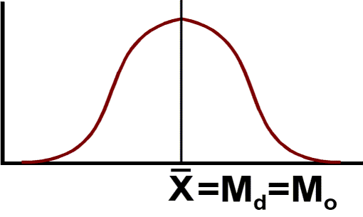
Common Errors
Central Tendency – Incorrectly rating all employees near the middle of the rating scale.

Slide 31

Common Errors
Halo Effect – the rater reacts to one positive performance aspect by rating the employee positively in all areas of performance.

Slide 32

Common Errors
Horns Effect – the rater responds to one negative performance aspect by rating the employee negatively in all areas of performance.

Slide 33
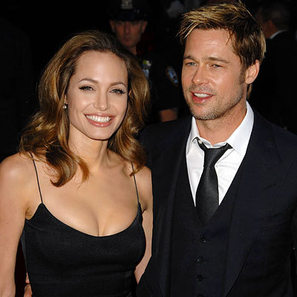
Common Errors
Workplace equivalent of the “Cute Kid Theory” – Higher ratings for people who are attractive, dress nice, are always upbeat, pleasant, everybody likes them, etc.

Slide 34
Skills:
Staff member role
Pastor’s role
Meeting
Follow-up: improvement plan
documentation
Notes:
Files, read previous files, employee input

Slide 35
Tools for appraisal
Job descriptions
Parish mission and goals
Individual goals
What is Your role in improving each person’s performance?
360 degree tools
Notes:
Talk about annual revision job descriptions
Ministerial or job related goals; Developmental goals
Always ask how you can help improve performance
Show them Archdiocese of Chicago tool

Slide 36
Small group discussion
Give specific examples of when this process has gone well?
  Why?
  How?
  Give specific examples of when this process failed.
  Why?
  What did you do to follow-up?

Slide 37
Miscellaneous issues:
Quantitative vs Qualitative reviews
Resistance
How to evaluate the process
How are directing; counseling; coaching; mentoring the same or different?

Slide 38
What Questions Do You Have?
Thank You

Slide 39
RESOURCES
MANY OF THE RESOURCES DEPICTED IN THE SLIDES ARE COURTESY OF:
ARCHDIOCESE OF CHICAGO
DEPARTMENT OF PERSONNEL SERVICES

Slide 40
LEADERSHIP ROUNDTABLE
Standards for Excellence
An Ethics and Accountability Code for
Catholic Dioceses
Catholic Parishes
Catholic Nonprofits

Slide 41
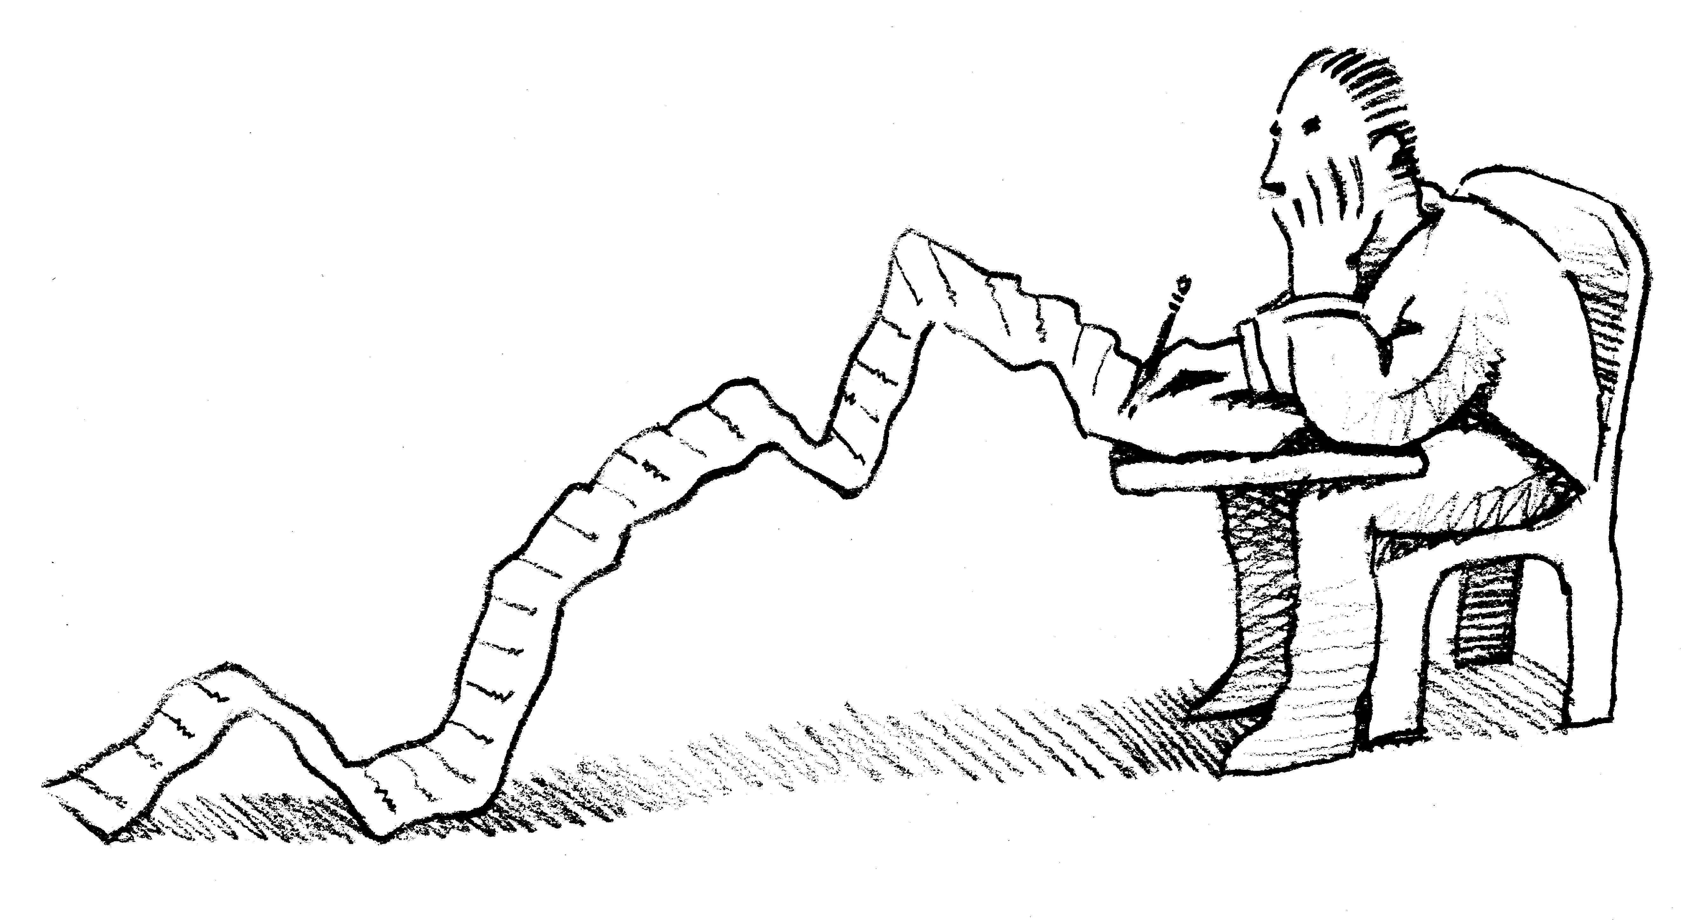
Standards for Excellence
Human Resources
Personnel Policies
Volunteer Policies
Employee Evaluation
Employee Orientation
Notes:
Main points covered:
-personnel policies
-volunteer policies
-employee evaluation
-employee orientation
(ask participants to discuss briefly the similarities and differences between their personnel and volunteer policies. Most will have personnel policies that are more detailed than what they have for volunteers.)
(ask particpants the kinds of questions they use in their employee evaluations. How often they evaluate their employees.)
(ask participants the benefit of having a formal evaluation process)

