Slide 1
CONCLUSION AND RESOURCES

Slide 2
SUMMARY
EFFECTIVE INSTITUTIONS SUPPORT, DIRECT, FOCUS AND CELEBRATE WORKER EFFORTS.
DEDICATED INDIVIDUALS LABOR, ASSIST, SUGGEST AND RESPOND TO INSTITUTIONAL INITIATIVES WHICH FURTHER THE CHURCH’S UNDERSTANDING AND PURSUIT OF ITS MISSION.

Slide 3
VALUES AND PRACTICES WHICH ENHANCE A HEALTHY WORKPLACE ENVIRONMENT
MISSION EFFECTIVENESS
SPIRITUAL LIFE
PARTICIPATORY ENVIRONMENT

Slide 4
VALUES AND PRACTICES WHICH ENHANCE A HEALTHY WORKPLACE ENVIRONMENT (CONTINUED)
    UPWARD COMMUNICATION
    VALUING AND MANAGING DIVERSITY
    PERSONNEL POLICIES

Slide 5
VALUES AND PRACTICES WHICH ENHANCE A HEALTHY WORKPLACE ENVIRONMENT (CONTINUED)
    COMMUNICATION ABOUT WORK PERFORMANCE
    WORK IMPROVEMENT PROCESSES
    PERSONAL CRISIS DETECTION AND INTERVENTION
    A SYSTEMATIC AND EQUITABLE APPROACH TO COMPENSATION

Slide 6
VALUES AND PRACTICES WHICH ENHANCE A HEALTHY WORKPLACE ENVIRONMENT
    INDIVIDUAL DEVELOPMENT
    CELEBRATION OF ACHIEVEMENTS

Slide 7
VALUES AND PRACTICES WHICH ENHANCE A HEALTHY WORKPLACE ENVIRONMENT
MISSION EFFECTIVENESS
SPIRITUAL LIFE
PARTICIPATORY ENVIRONMENT
    Attritbution: The slides on “Values and Practices” are from, The Individual and the Institution, A Position Paper of the National Association of Church Personnel Administrators, 1994.

Slide 8
VALUES AND PRACTICES WHICH ENHANCE A HEALTHY WORKPLACE ENVIRONMENT (CONTINUED)
    UPWARD COMMUNICATION
    VALUING AND MANAGING DIVERSITY
    PERSONNEL POLICIES

Slide 9
VALUES AND PRACTICES WHICH ENHANCE A HEALTHY WORKPLACE ENVIRONMENT (CONTINUED)
    COMMUNICATION ABOUT WORK PERFORMANCE
    WORK IMPROVEMENT PROCESSES
    PERSONAL CRISIS DETECTION AND INTERVENTION
    A SYSTEMATIC AND EQUITABLE APPROACH TO COMPENSATION

Slide 10
VALUES AND PRACTICES WHICH ENHANCE A HEALTHY WORKPLACE ENVIRONMENT
    INDIVIDUAL DEVELOPMENT
    CELEBRATION OF ACHIEVEMENTS

Slide 11
RESOURCES

Slide 12
LEADERSHIP ROUNDTABLE
Standards for Excellence
An Ethics and Accountability Code for
Catholic Dioceses
Catholic Parishes
Catholic Nonprofits

Slide 13
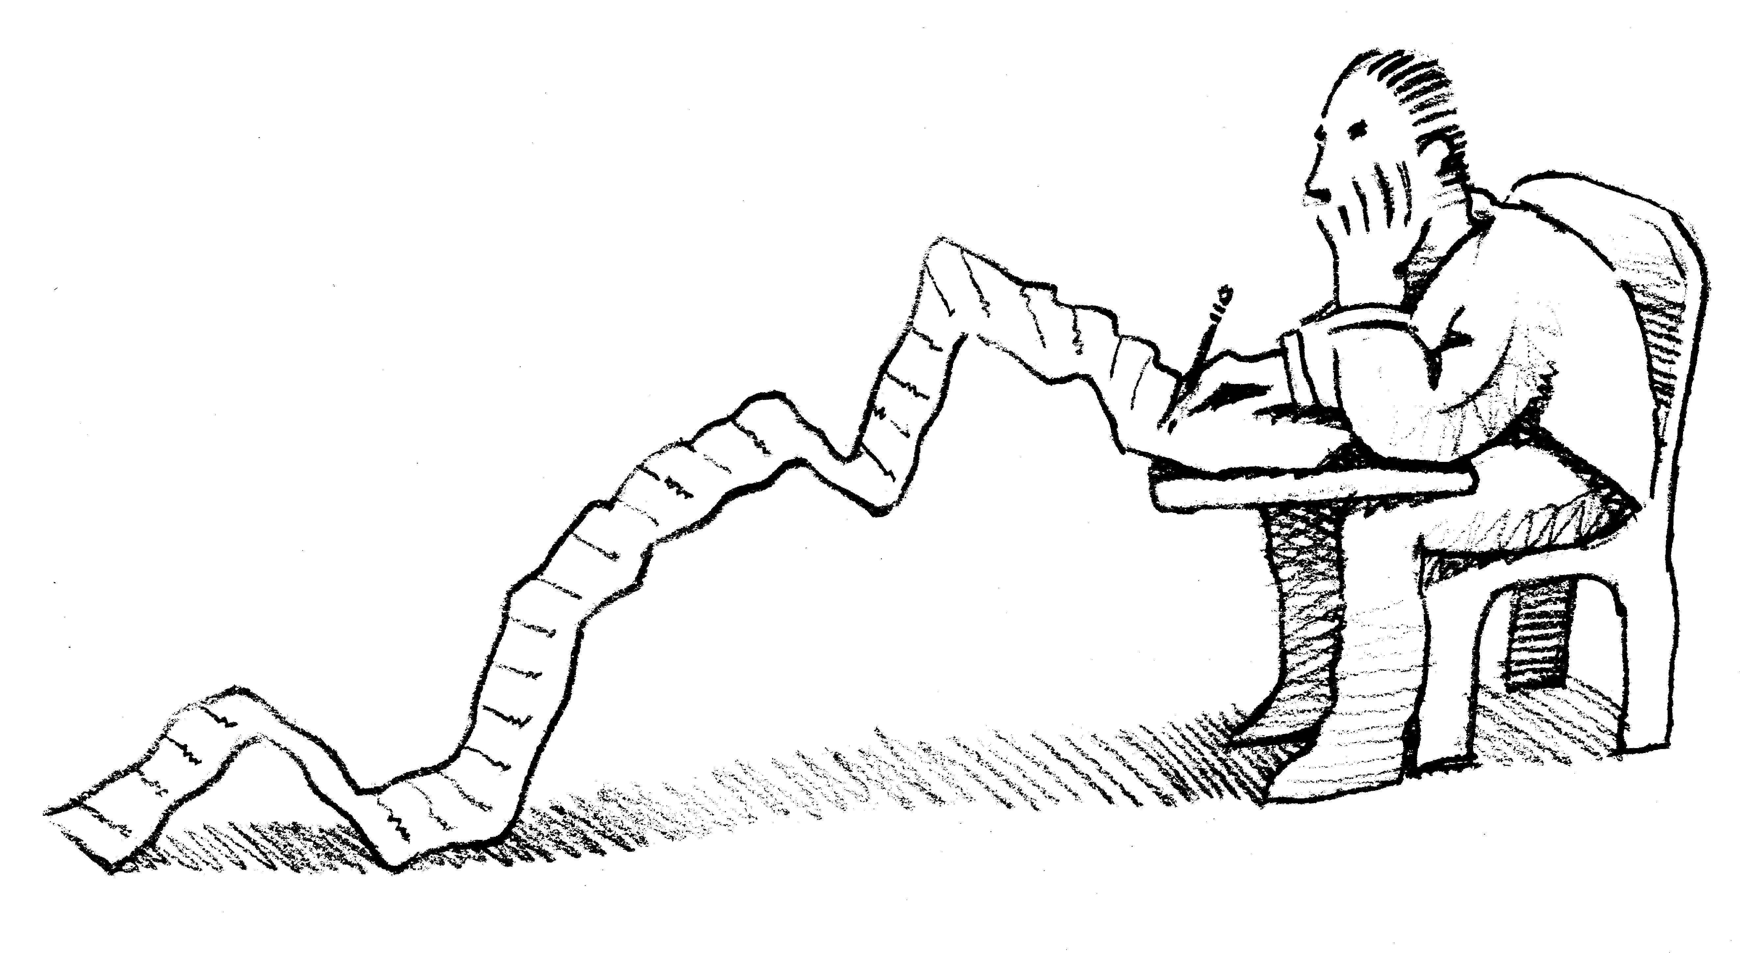
Standards for Excellence
Human Resources
Personnel Policies
Volunteer Policies
Employee Evaluation
Employee Orientation
Notes:
Main points covered:
-personnel policies
-volunteer policies
-employee evaluation
-employee orientation
(ask participants to discuss briefly the similarities and differences between their personnel and volunteer policies. Most will have personnel policies that are more detailed than what they have for volunteers.)
(ask particpants the kinds of questions they use in their employee evaluations. How often they evaluate their employees.)
(ask participants the benefit of having a formal evaluation process)

Slide 14
NACPA
THE INDIVIDUAL AND THE INSTITUTION:
  Strengthening Working Relationships in the Church
Parish Job Description Manual, 2006, NACPA
The Laborer is Worthy of His Hire, William Daly, National Federation of Priests’ Councils
Personnel Policies and Procedures for Church Organizations Ed. William Daly, NACPA
Wage and Salary Survey of Catholic Parishes 2007, NACPA
www.nacpa.org

Slide 15
Villanova Center for Church Management
Established in 2004
Located Administratively in the Villanova School of Business
  The Church is not a business, but we do have a stewardship responsibility to use our resources effectively. Frequently that involves the use of sound business management techniques
Generate/Disseminate Knowledge
  Four books on a variety of church management topics
  Seminal Report on Church Embezzlement
  Quarterly Newsletter sent electronically to 11,000 US parishes

Slide 16
STRENGTHS BASED PASTORAL LEADERSHIP
Gallup Organization
  Growing an Engaged Church by Winseman
  Living Your Strengths Catholic Edtion by Winsemnan, Clifton, and Liesveld
  Go Put Your Strengths to Work by Buckingham
  How Full is Your Bucket by Rath and Clifton
  Strengths Based Leadership by Rath and Conchie

Slide 17
BOOKS cont.
A Pastor’s Toolbox 2, Paul Holmes, editor. Liturgical Press, Collegeville, MN, 2017
Parish Finance, Best Practices inChurch Management. Michael J. Castrilli and Charles Zech, Paulist Press, 2016
Redeeming Administration, Ann Garrido, Ave Maria Press, 2013
Redeeming Conflict, Ann Garrido, Ave Maria Press, 2016
The Gift of Administration, Donald Senior, Liturgical Press, 2016
Parish Leadership, Principles and Perspectives, William J Byron, 2017

Slide 18
Books cont.
Lencioni, Patrick Death by Meetings
Lencioni, Patrick, The Five Dysfunctions of a Team
Navigating Pastoral Transitions, Ave Maria Press

Slide 19
RESOURCES cont.
BOOKS
Effective Phrases for Performance Appraisals, Neal Publications, 127 W Indiana Ave, Perrysburg, OH 43551
Perfect Phrases for Setting Performance Goals, Max, Douglas and Bacal, Robert, McGraw Hill
Co-Workers in the Vineyard, USCCB
Just Wages for Church Employees, Almade, Frank, Peter Lang Publishing

Slide 20
TODAY’S DISCUSSION
What are reasonable expectations that staff members have of the Church related employer?

Slide 21
TODAY’S DISCUSSION cont
What are reasonable expectations that the parish or Church employer may have of staff?

Slide 22
SOME REASONABLE STAFF EXPECTATIONS
    Fair pay and benefits.
    Safe and healthy working conditions.
    A workplace environment which is free of inappropriate or harmful substance use and abuse and which provides assistance to workers attempting to free themselves of such problems.

Slide 23
SOME REASONABLE STAFF EXPECTATIONS (CONT..)
    A workplace which respects personal differences, avoids discrimination due to age, gender, race, national origin, or disability and educates workplace members on the merits and methods of valuing workplace diversity.
    A workplace which prohibits all forms of harassment and actively addresses allegations and corrects incidents of harassment.

Slide 24
SOME REASONABLE STAFF EXPECTATIONS (CONT..)
    Openness to membership in an association or labor union.
    Knowledge of material placed in one's personnel file; the protection of confidentiality in the maintenance of personnel files.
    Advance notice of changes with a significant impact on the working relationship.

Slide 25
SOME REASONABLE STAFF EXPECTATIONS (CONT..)
    Security against arbitrary or capricious dismissal.
    A grievance procedure or similar process to use in seeking to reconcile workplace differences.
    Safeguards in the workplace against violations of personal privacy.

Slide 26
SOME REASONABLE STAFF EXPECTATIONS (CONT..)
    Clearly written, publicly disseminated, and fairly administered personnel policies as well as workplace and organizational policies.
    A sense of dignity and personal worth gained in using talents, skills, and creativity and in receiving respect, trust, and confidence.

Slide 27
SOME REASONABLE STAFF EXPECTATIONS (CONT..)
    Orientation to the mission and culture of the organization and to one's chief responsibilities, early in one's tenure on the job.
    A current, up-to-date job description which provides clarity of expectations about duties and responsibilities.

Slide 28
SOME REASONABLE STAFF EXPECTATIONS (CONT..)
    A clear understanding of worker roles, degrees of authority, and where one fits in the institution.
    The ability to contribute to decisions involving daily work.

Slide 29
SOME REASONABLE STAFF EXPECTATIONS (CONT..)
    The ability to participate in the development of performance expectations for one's job.
    Timely and honest feedback including appraisal of both successes and failures; and, on a more formal level, periodic performance reviews.

Slide 30
SOME REASONABLE STAFF EXPECTATIONS (CONT..)
    A training and development program that adequately prepares one for specific responsibilities.

Slide 31
SOME REASONABLE INSTITUTIONAL EXPECTATIONS
    Individual workers who regularly perform their assigned duties in a complete and timely manner.
    Workers who abide by reasonable rules of workplace conduct.

Slide 32
SOME REASONABLE INSTITUTIONAL EXPECTATIONS
    Honesty and care in the use of institutional materials and resources.
    Cooperation, commitment, and flexibility when the need arises to perform unusual duties or to work beyond normal hours.

Slide 33
SOME REASONABLE INSTITUTIONAL EXPECTATIONS
    Acceptance of the institution's need to hire fully qualified workers, to determine the qualifications required for jobs and to determine the need to hire practicing members of the faith for certain or all jobs as appropriate.

Slide 34
SOME REASONABLE INSTITUTIONAL EXPECTATIONS (Continued)
    A general understanding of the institution's need to determine the continuing status of each position and its incumbent in light of the institution's mission, its fiscal resources, and individual work performance.

Slide 35
SOME REASONABLE INSTITUTIONAL EXPECTATIONS (Continued)
    Individuals who understand, accept and contribute to the institution's mission with commitment, initiative and responsibility.
    Acceptance of the institution's need to establish policies, procedures, and control mechanisms to achieve its mission and compliance with them once established.

Slide 36
SOME REASONABLE INSTITUTIONAL EXPECTATIONS (Continued)
    Individuals who alert supervisors and others in leadership positions to organizational problems.

Slide 37
SOME REASONABLE INSTITUTIONAL EXPECTATIONS
    Acceptance of the institution's need to obtain appropriate background information from applicants and current workers and to use that information in placement decisions.
    Individuals who interact with others with dignity, cooperation and respect.

