Slide 1
Building Effective Teams (Moving from SiloS to TeamS)
Sal Della Bella
Director, Office of Parish Leadership Development
502-585-3291 ext. 1114
sdb@archlou.org
Assembly Resources @ www.archlou.org/grant

Slide 2
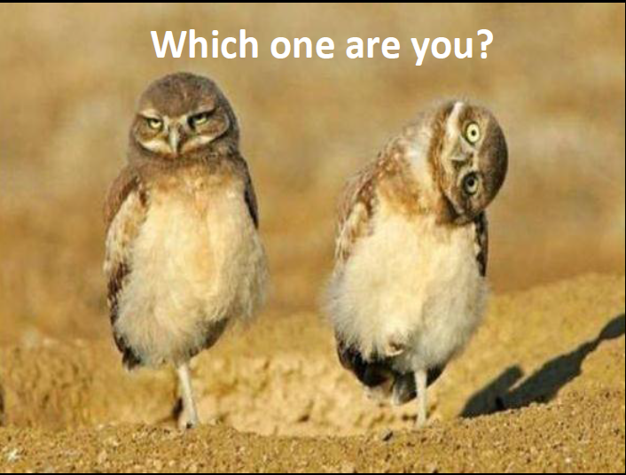

Slide 3
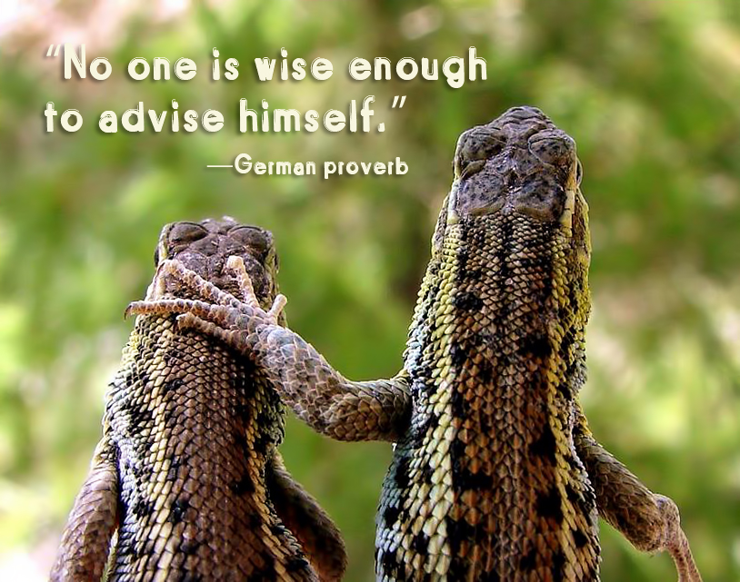

Slide 4
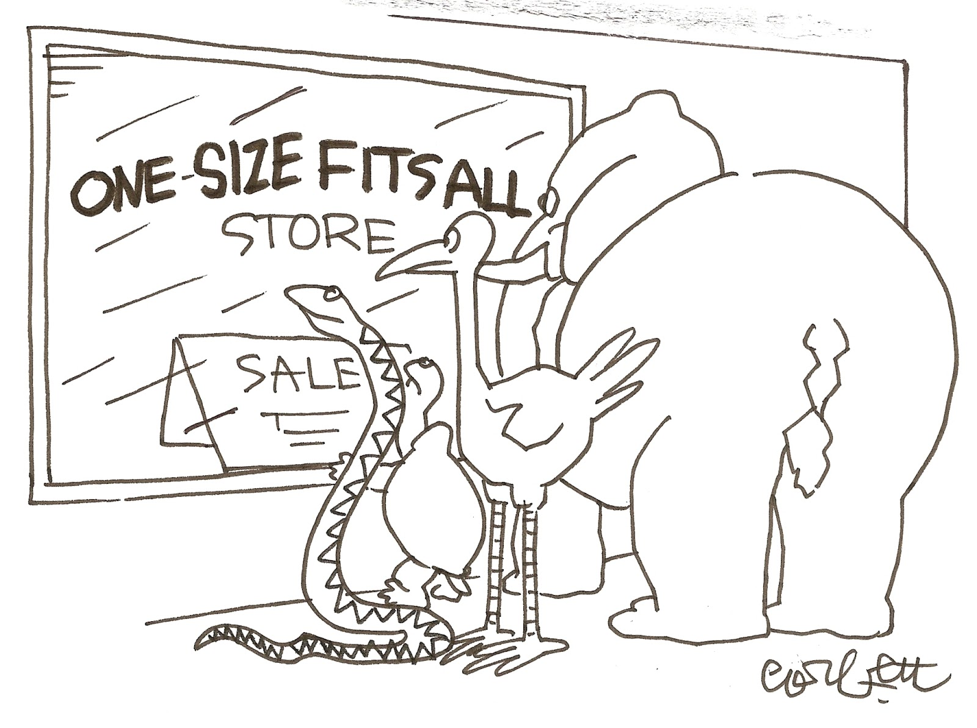

Slide 5
What is a Team?
"A team is a small number of people with complementary skills who are committed to a common purpose, performance goals, and approach for which they are mutually accountable."
Katzenbach, J.R. & Smith, D.K. (1993). The Wisdom of Teams: Creating the High-performance Organization. Boston: Harvard Business School.

Slide 6
What is wrong with this picture?
“I've got it, too, Omar…a strange feeling like we've just been going in circles”
Notes:
Brainstorm with them

Slide 7
School
Sports
RE
Outreach

Slide 8
Proverbs 29:18
Without a Vision the People Perish

Slide 10
REMEMBER TO
TAKE OUT THE TRASH

Slide 11
T
rust
espect
ccountability
hared Purpose/Vision
onesty
R
A
S
H

Slide 12
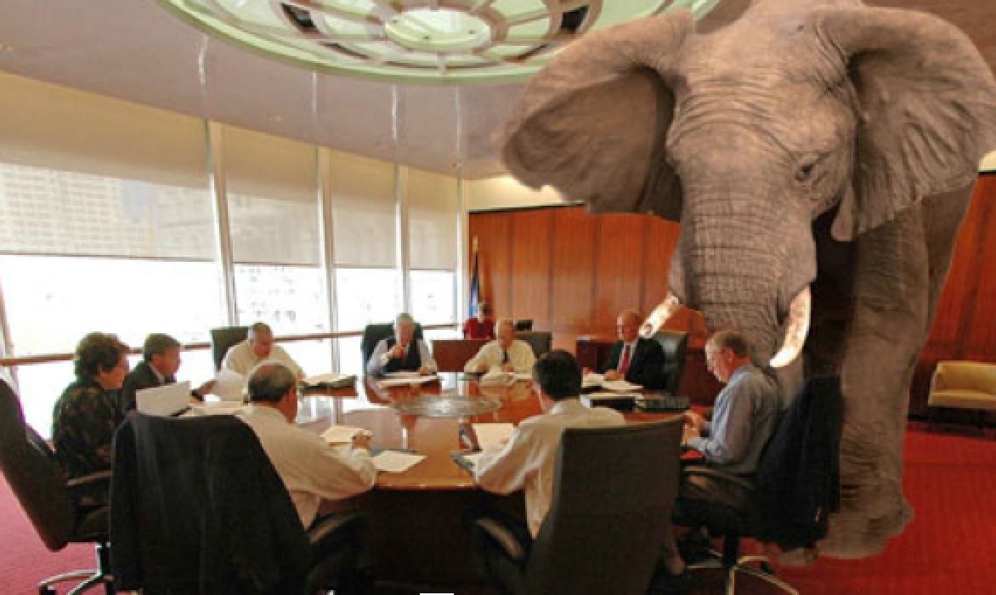

Slide 14
Team Assessment
Team Building
Gift Assessment/Strength Finders
New Leader Assimilation
Retreats
Planning/Visioning
Prayer
Professional Development
Meetings
Purpose
Agenda
Action
Evaluations

Slide 15
Our Team Assessment High Medium Low
Each has gifts 13 2 1
Everyone contributes 10 5 1
Equal value of all 10 5 1
Specific roles 10 1 5
Respect and support 7 6 3
Common vision 5 3 8
Clarity of vision 3 5 8
Clear communication 1 9 6
Mutual Accountability (feedback) 1 7 8

Slide 16
Team Assessment
Team Building
Gift Assessment/Strength Finders
New Leader Assimilation
Retreats
Planning/Visioning
Prayer
Professional Development
Meetings
Purpose
Agenda
Action
Evaluations

Slide 17
Team Assessment
Team Building
Gift Assessment/Strength Finder
New Leader Assimilation
Retreats
Planning/Visioning
Prayer
Professional Development
Meetings
Purpose
Agenda
Action
Evaluations

Slide 18
Process: 3 gatherings plus follow up
Facilitator meets with team/staff to surface questions, hopes, concerns
Facilitator shares data with new leader
New leaders and team/staff meet for discussion together with facilitator
Follow up between new leader and team/staff
Discussion Questions
What do we already know about the new Director?
What don't we know, but would like to know about our new Director?
What are our concerns, both group and individual, about this person becoming our new Director?
What do we want or need most from the new Director?
What would we like the new Director to know about us, either as individuals or as a group?
What are the major issues we think the new Director will be focusing on during the first year?
What are we looking forward to most in this coming year?

Slide 19
Team Assessment
Team Building
Gift Assessment/Strength Finder
New Leader Assimilation
Retreats
Planning/Visioning
Prayer
Professional Development
Meetings
Purpose
Agenda
Action
Evaluations

Slide 20
REMEMBER TO
TAKE OUT THE TRASH

