Slide 1
Archdiocese of Louisville
Best Practices in Church Financial Management
Hour of Church Financial Power
Michael Castrilli
Philadelphia, PA
mjcastrilli@gmail.com
June 2017

Slide 2
Opening Comments
Goal | Objective
Practical Provide outcome-oriented solutions
Exciting Bring energy and spirit to the topic
Accessible Learn the vocabulary of finance
Parish-Focused Discuss actual challenges/common questions relevant to parish life
Faith-Based Center topic in the life of a Christian community
Resourceful Offer resources for further study

Slide 3
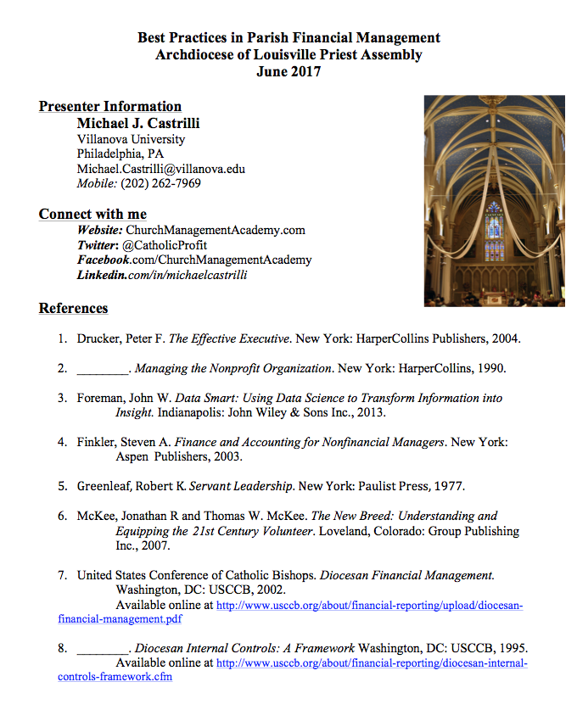
Resources
Bibliography
Terminology

Slide 4

The Gospel as our Guide
“The best organizational practices are consistent with Gospel values. They balance the goals and needs of the organization, its workers and the community in which it is located.”
Source: United States Conference of Catholic Bishops (USCCB), Co-Workers in the Vineyard of the Lord (Washington, DC: USCCB, 2005), 61.

Slide 5
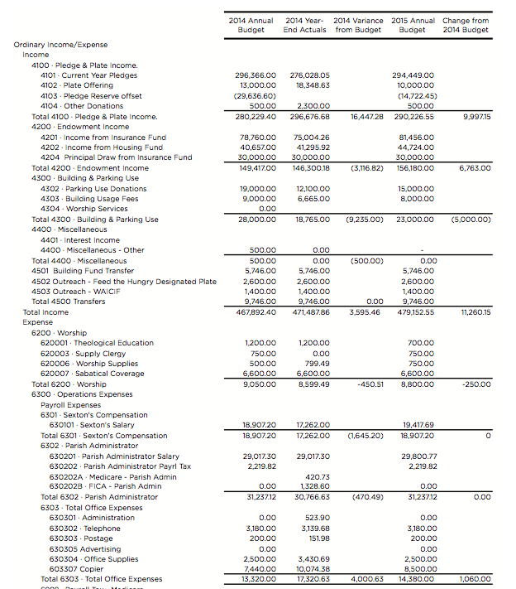
Where Do I Begin?

Slide 6
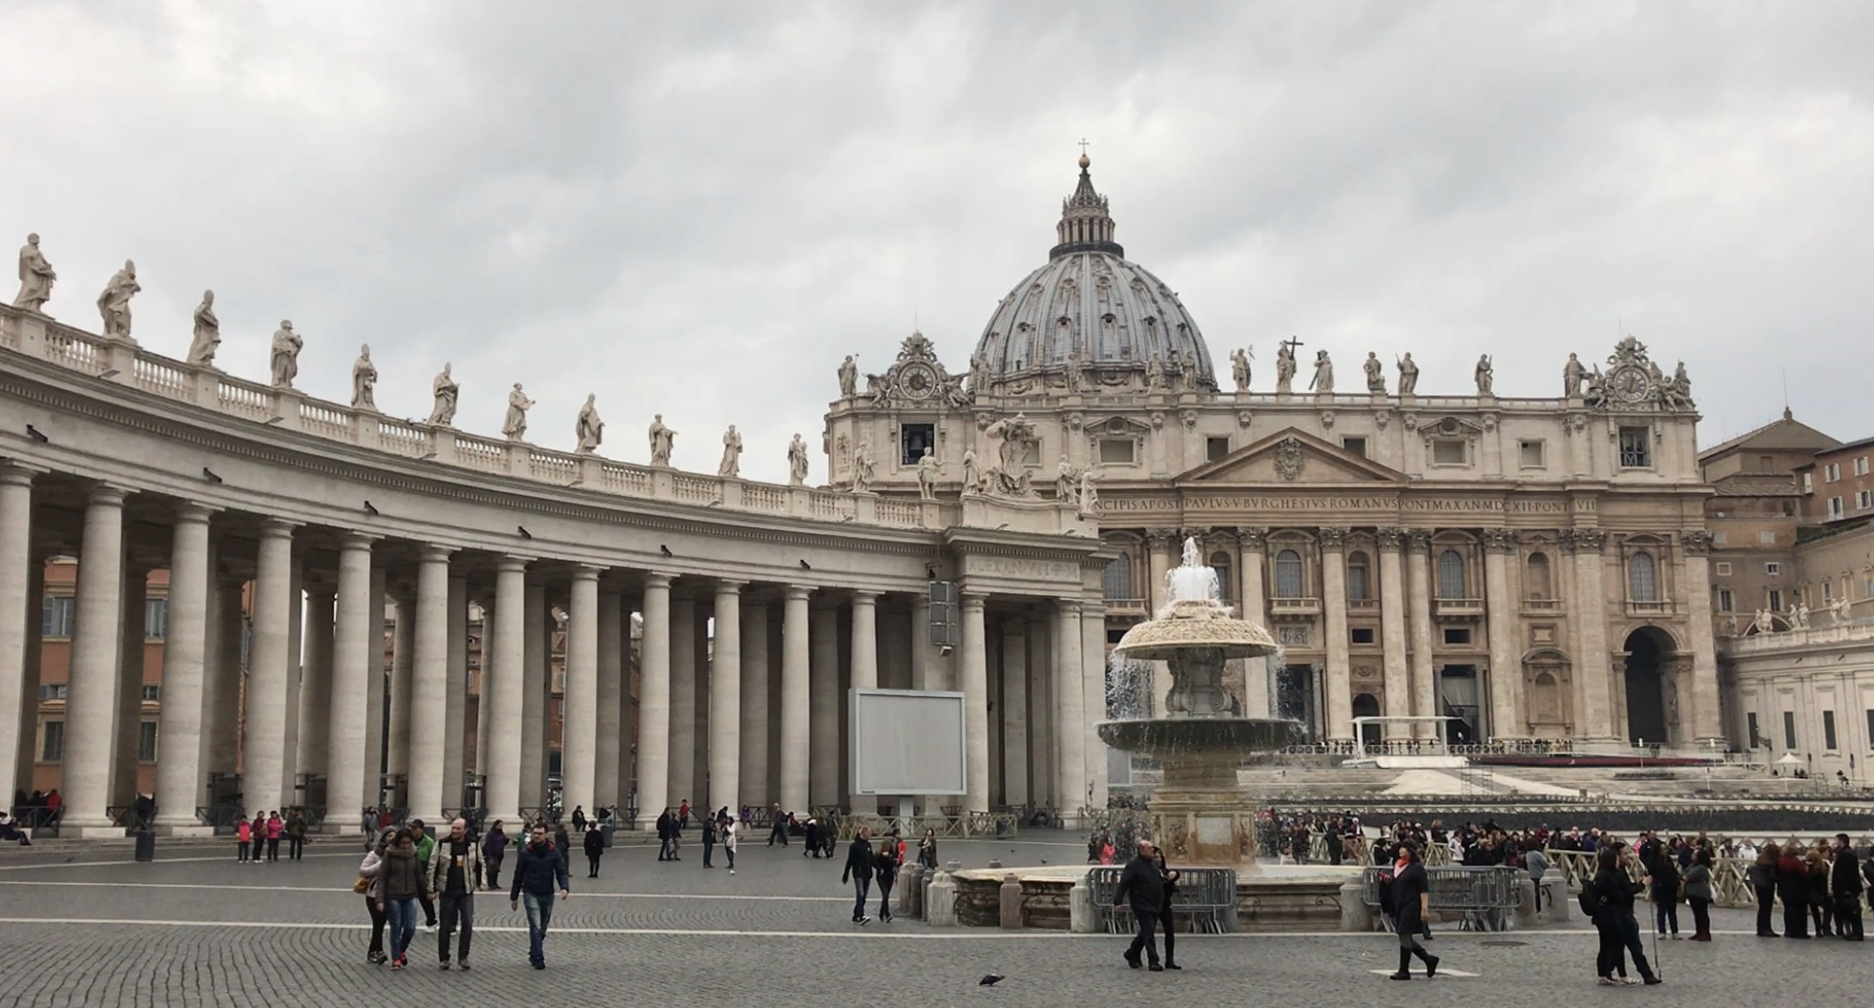
1. Teach others that budgets are about freedom, not constraint

Slide 7
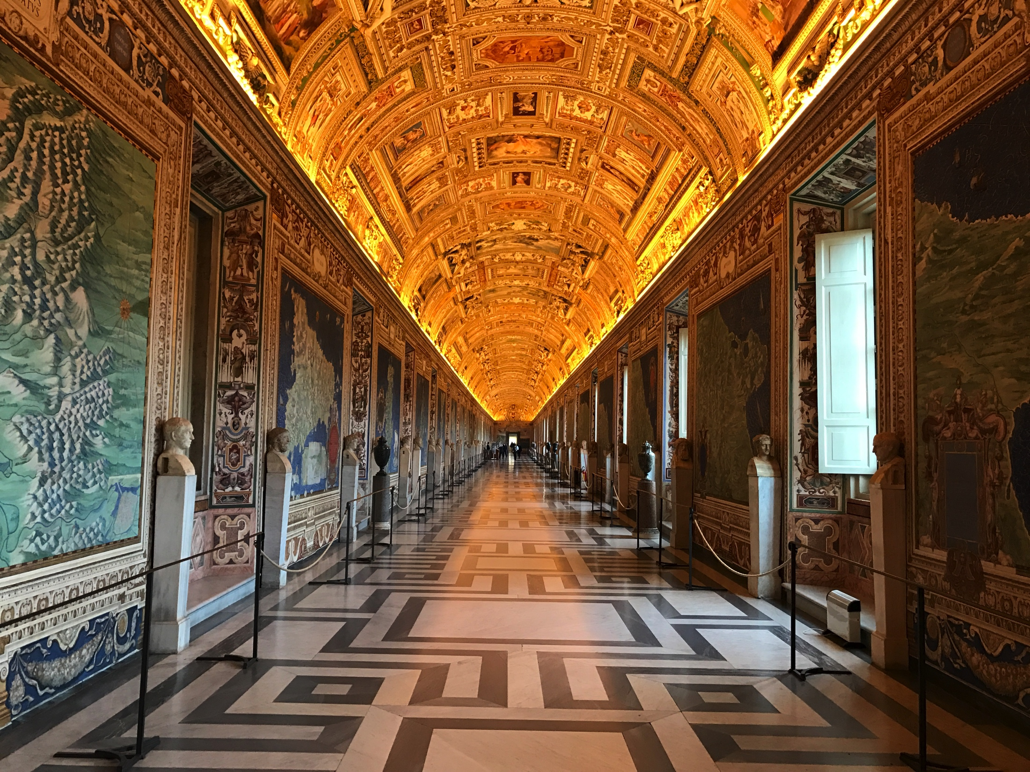
Budget Basics
It is all about priorities
A “road map” to help you get from where you are to where you are going.
Makes “limits” clear.

Slide 8
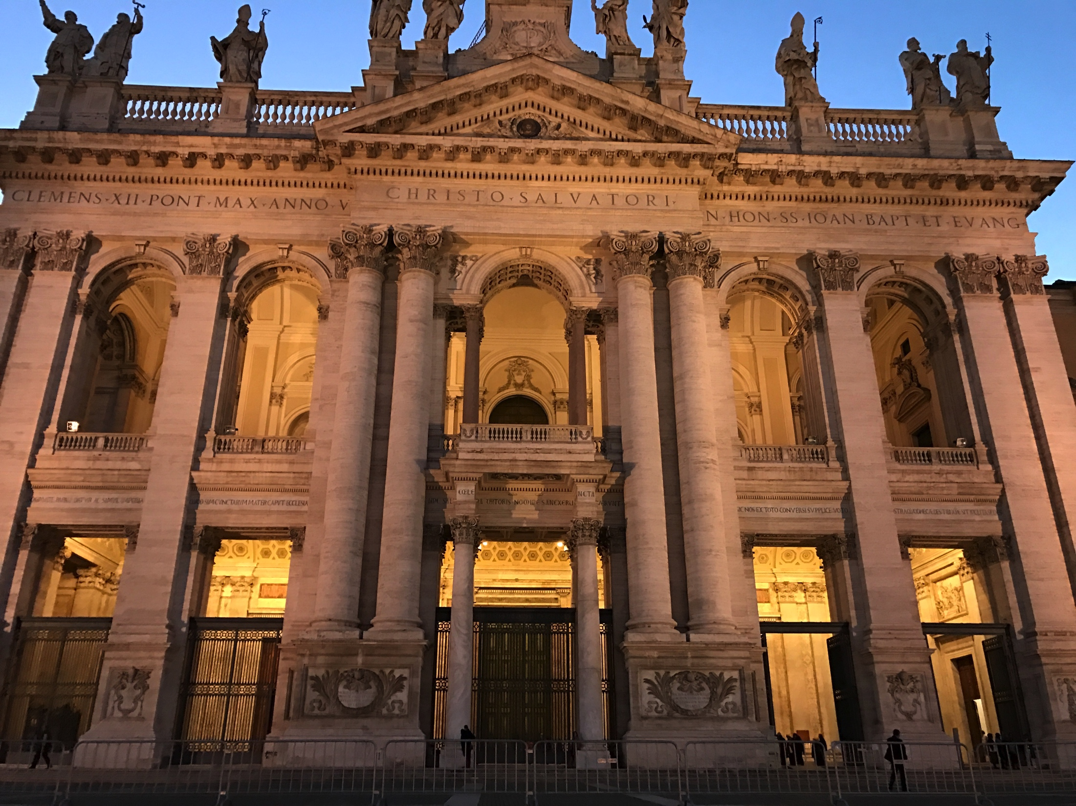
2. Collaborate on the budget to gain buy-in. Share the budget before it is final.

Slide 9
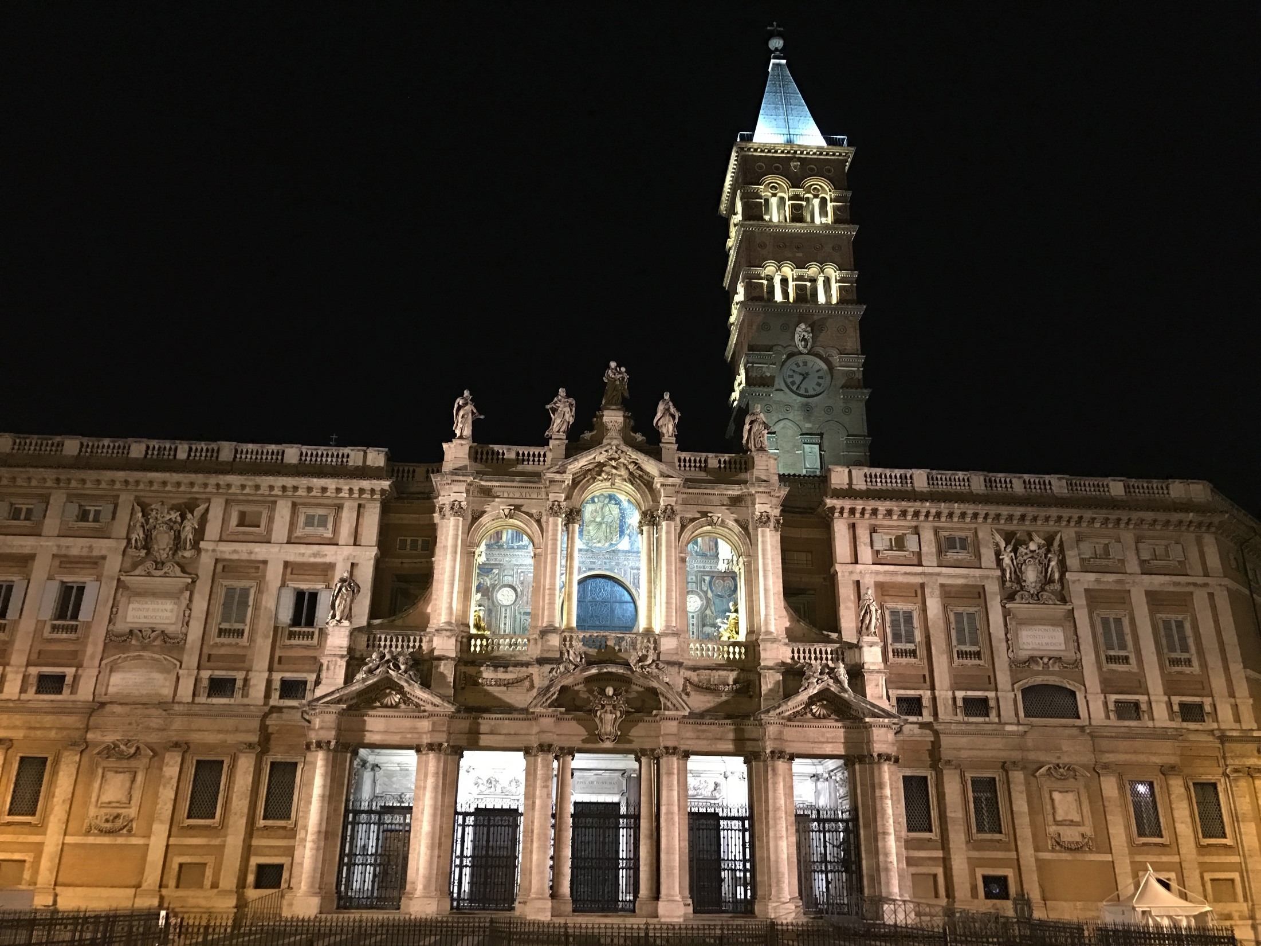
3. Prioritize to Strategize Time, Money, and People

Slide 10
Use Budget Category Impact % (BCIP_
Category | Amount | % of Total
Income
Collections | $707,000 | 95%
Donations | $16,500 | 2%
Programs | $7,500 | 1%
Other Income | $14,000 | 2%
Total | $745,000 | 100%
Expenses
Personnel/Salary | $182,000 | 28%
Personnel/Other | $82,121 | 13%
Diocesan Assessment | $70,700 | 11%
Administrative/Office | $89,145 | 14%
Liturgical/Sacramental | $45,500 | 7%
Programs | $58,000 | 9%
Plant/Facilities | $115,700 | 18%
Total | $643,166 | 100%
Surplus/Deficit | $101,834

Slide 11
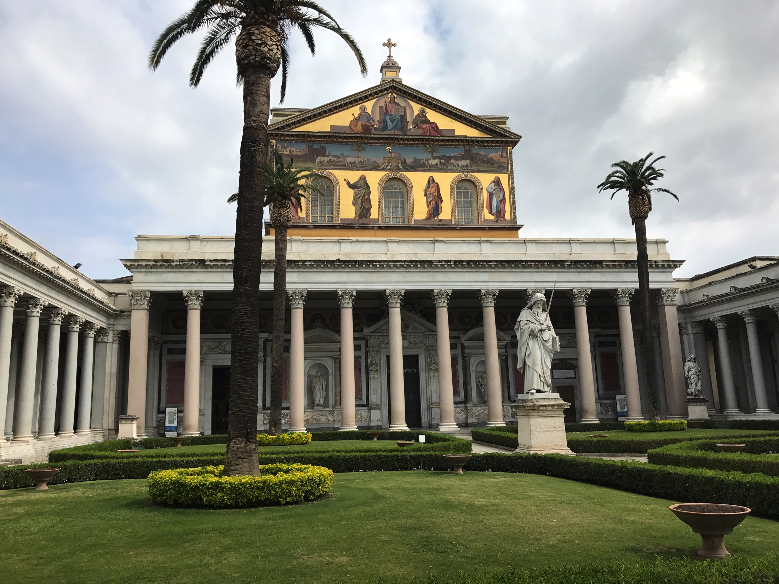
4. Create a Cash Flow Budget to address fluctuations in revenues and expenses

Slide 12
The Cash Flow Budget
Addresses fluctuations of income and expenses
Estimates for the amount of money that the parish expects to receive and expects to spend for a given time period.
Broken down by months, week or even days.

Slide 13
Cash Flow Budget Example (cont’d)
 | Jan | Feb | Mar | Apr | May | Jun | Jul | Aug | Sep | Oct | Nov | Dec | Total
Income | $850 | $756 | $900 | $980 | $1,100 | $1,150 | $1,200 | $1,175 | $1,076 | $946 | $980 | $900 | $12,013
Expenses | $1,100 | $1,000 | $950 | $950 | $900 | $900 | $925 | $925 | $800 | $700 | $800 | $985 | $10,935
Surplus (Deficit) | -$250 | -$244 | -$50 | $30 | $200 | $250 | $275 | $250 | $276 | $246 | $180 | -$85 | $1,078

Slide 14
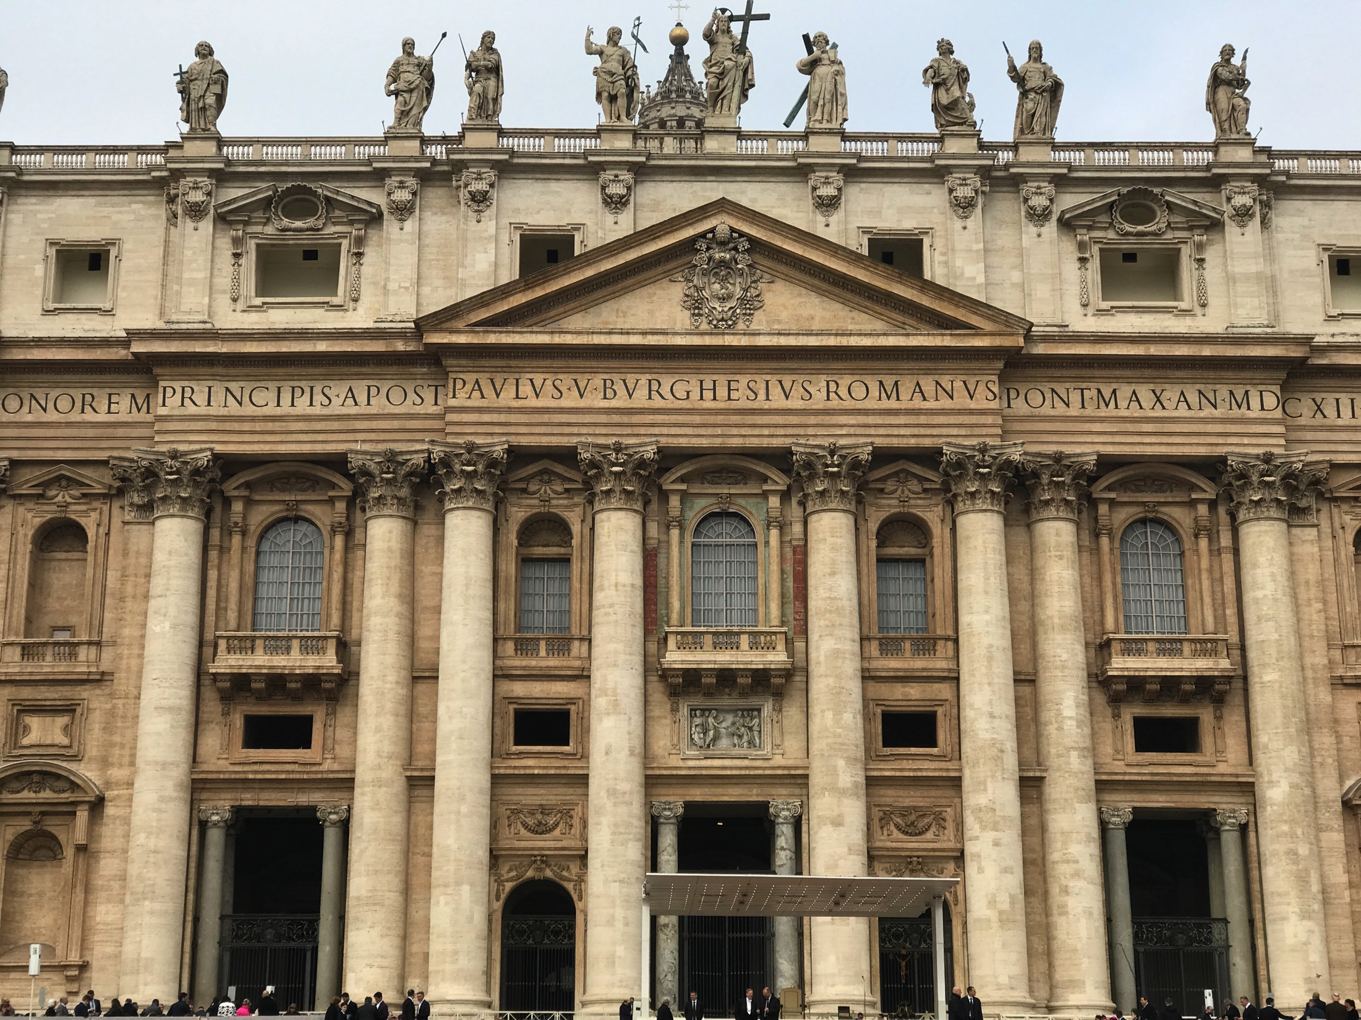
5. Develop a Capital Budget
Capital assets are items you own that have value that extend beyond at least one year

Slide 15
Starting up a Capital Budget
Step 1 - Create a list of all capital assets
Step 2 – Age
  Create a column with age
  Create a column on how long the asset is expected to last
Step 3 – Condition
  Code them for state of condition – Great, Ok, Poor
Step 4 – Prioritize list – Establish timeframe

Slide 16

6. Develop a performance dashboard to stay on track

Slide 17
Variance Analysis Example
1 | 2 | 3 | 4 | 5
Category | $ Budgeted Amount (January – March 2014 ) | $ Actual Amount (April 1, 2014) | $ Variance Over/Under Budget = Budgeted – Actual | % Variance Over/Under Spent = (Variance / Budgeted) X 100
Office and Technology | $17,000 | $18,000 | -$1,000 | - 6%
Utilities | $12,000 | $12,250 | -$ 250 | -2%
Liturgical and Sacramental | $25,000 | $22,500 | $2,500 | 10%
Tips:
Note that variance is always a snapshot in time
Establish Process to evaluate results

Slide 18
Variance Analysis - Stoplight
1 | 4 | 5
Category | % Over/Under Spent | Analysis
Office and Technology | - 6% | - 6%
Utilities | - 2% | - 2%
Liturgical and Sacramental | 10% | 10%
Variance + or - Greater than 10%
Variance + or –Between 5%- 9%
Variance + or –
Less than 5%

Slide 19
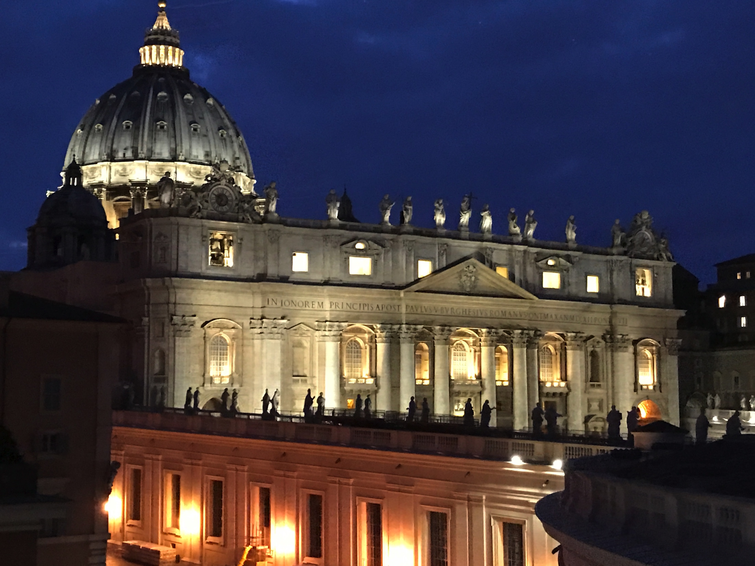
7. Safeguard parish assets with internal controls
What are the policies and procedures for safeguarding Cash, Sunday collections, etc.?

Slide 20
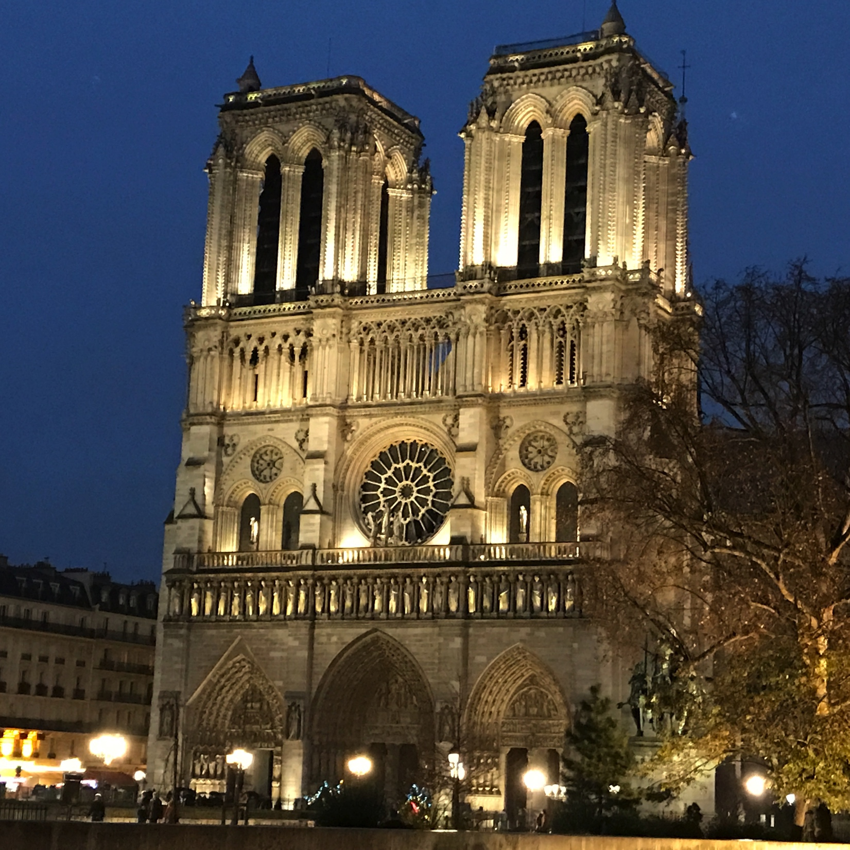
8. Conduct a skillset analysis on your pastoral and finance councils

Slide 21
Skillset Matrix
 | Skill #1 | Skill #2 | Skill #3 | Skill #4 | Skill #5 | Skill #6
Person A
Person B
Person C
Person D
Person E
Person F
E = Expert I = Intermediate B – Beginner (Blank) = No Experience
XXX XX X

Slide 22
Skillset Matrix
 | Budgets | Formation | Youth | Theology | Social Media
Pastor | XX | XX | XX | XXX
Acct | XXX |  |  |  | XX
DRE | X | XX | X | X | X
Music Director | X |  |  |  | X
Youth Coordinator |  |  | XXX |  | XXX
E = Expert I = Intermediate B – Beginner (Blank) = No Experience
XXX XX X
22

Slide 23
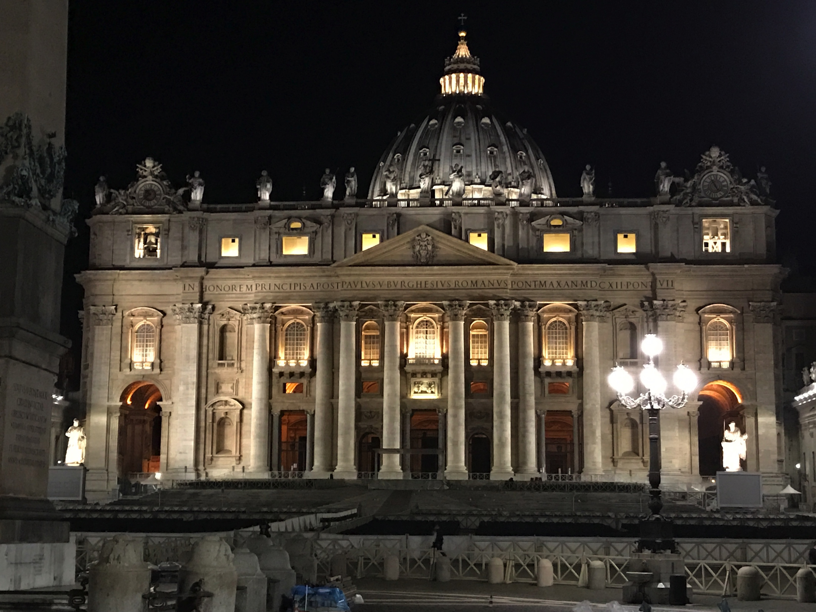
9. Use stewardships tools to help with increase revenues and stabilize

Slide 24
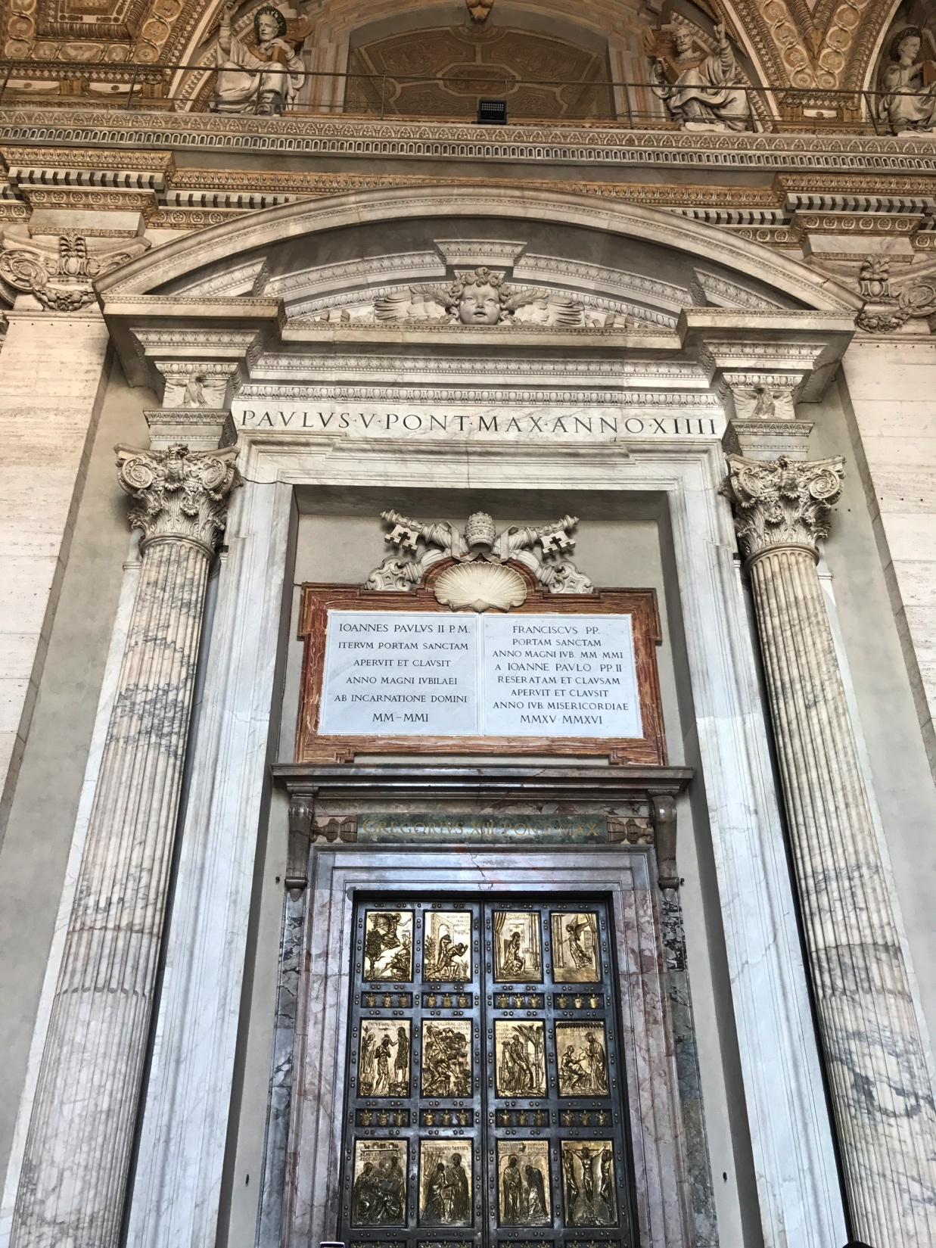
10. Communicate church financial information with impact and ease

Slide 25
How do you determine which visual to use?
Make it Clear
Make it Collaborative
Make it Concise
What is your goal?
What are your criteria?
Is this better written or visualized?
What is the story that the visual is telling?
Is it clear?
Is it distinguishable?

Slide 26

Questions
For further questions or discussion, please do not hesitate to contact me at:
Michael Castrilli
Michael.castrilli@villanova.edu
(202) 262-7969

Slide 27
Appendix Table of Contents
Financial Management Terms
Cost Benefit Analysis
Time Value of Money
Breakeven Analysis
Activity Based Costing
Qualitative Scoring
Technological Resources
Succession Planning

Slide 28
Appendix Slides

Slide 29
Church Budgeting and Financial Management
Strategic Plan - Mission - Vision
Resource Allocation
Financial Execution & Control
Financial Analysis
Budget Formulation
Control Procedures
Cost Benefit Analysis
Variance Analysis
Breakeven Analysis
Income, Expenses, Forecasting and Baselines
Reporting
Activity Based Costing

Slide 30
The Master Budget
Parish Mission/Vision/Goals
Operating Budget (Annual)
Capital Budget (Multi-Year)
Income
Expenses
Capital Expenditures
Accounts and Investments
Checking/Savings
Deposits with the Diocese
Master Budget
Budget Assumptions

Slide 31
Assessment and Evaluation Tools
Surveys
Focus Groups
Town Halls
SWOT Analysis
Other Tools

Slide 32
The Master Budget
Parish Mission/Vision/Goals
Master Budget
Operating Budget (Annual)
Capital Budget (Multi-Year)
Accounts and Investments
Income
Expenses
Capital Expenditures
Checking/Savings
Deposits with the Diocese

Slide 33
The Operating Budget
Reflects the day-to-day cash inflows and outflows to keep the parish running smoothly.
Churches receive a majority of their revenue from collections (offerings) and smaller portions for other categories like bulletin income, stole fees, account interest, etc.
Operating expenses include salary and benefits, utilities, maintenance costs, and programming (religious education), etc.

Slide 34
The Capital Budget
Spending plan for updating, repairing, maintaining, or purchasing capital assets.
Capital assets – Assets that the parish owns that have value extending beyond a year.
  Examples: Church Building/Rectory
Create a three to five year (or more) budget
Catalog capital assets
Consider any new planned investments and ensuring that you build into the budget the expected useful life of the assets

Slide 35
Capital Budget Considerations
Capital improvements – Do you have any significant projects planned for new buildings, additions, major refurbishes or upgrades?
Asset purchases – Do you anticipate any purchases of new equipment like computers, software (e.g. financial management system) or other assets that will be available beyond one year?
Equipment repair – Do you have equipment that might require repair in the upcoming years? Is money available for unexpected equipment breakdowns?
Facility upgrades – Are there any updates planned or necessary? Examples might include painting, carpeting, or retrofitting classrooms for new LCD screens.
Deferred maintenance – Have resource been allocated for the replacement of assets before they fail? This category also includes scheduled or routine maintenance (e.g. the annual boiler inspection) to ensure that assets last for their expected useful life.

Slide 36
The Cash Flow Budget
Addresses fluctuations of income and expenses
Estimates for the amount of money that the parish expects to receive and expects to spend for a given time period.
Broken down by months, week or even days.

Slide 37
Cash Flow Budget Example

Slide 38
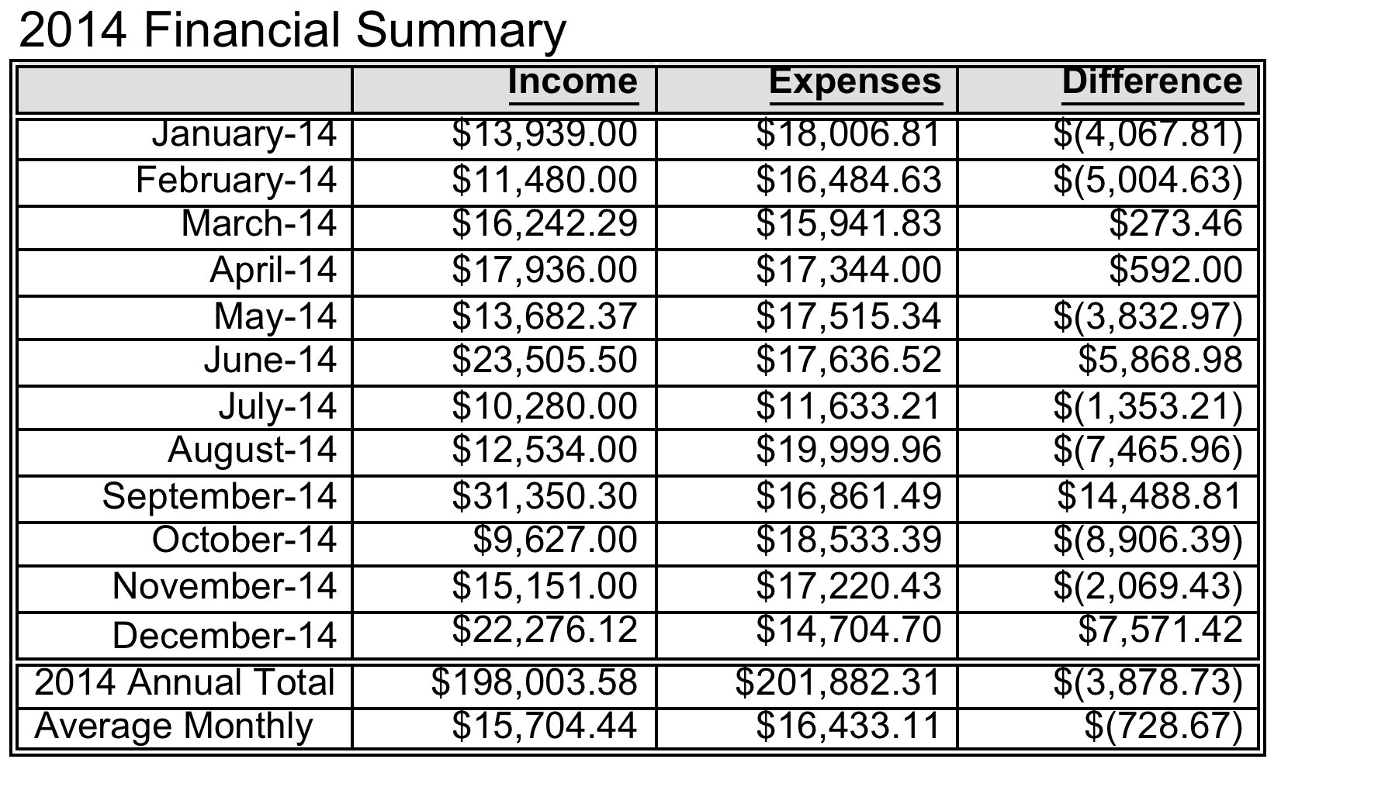
More information?

Slide 39
Example: Holy Cross Income

Slide 40
Cash Flow Strategy
Step 1: Collect Data/Prioritize Time
Step 2: Analyze and Visualize
Step 3: Forecast and Document Assumptions
Step 4: Present and Finalize

Slide 41
Step 1: Collect Data and Prioritize Time
Review past budgets
  Prior Year Budget and Actuals
  Data from other years
Divide and conquer
Formulate questions
Prioritize your time – invest your scarce resources

Slide 42
Calculate the Budget Category Impact %
With limited time, focus on income and spending categories with a largest impact on budget
Calculate the % of Impact =
Spending Category Total
Total Budget
2. Determine Breakpoints and Highlight Priority Categories for Review
3. Review/Focus on Priority Categories

Slide 43
Step 2: Analyze and Visualize
Where do we see “Bumpiness”
Review variances by comparing budgeted to actuals
Visualize information
Assess challenges and opportunities

Slide 44
Example: Holy Cross Income

Slide 45
Step 3: Forecast and Document Assumptions
Forecast as Informed/Educated Guess
Historical Data
  Data series
  Incremental
  Regression
Techniques when Historical Data Not Available
  Nominal Group
  Delphi Methods

Slide 46

Church Income Categories
Collections
  Sunday, Holy Day, Church Needs
Liturgical and Sacramental Income
Other Operating Income
  Bulletin, Publications, Gift Store, Rental Income
Development Income
Subsidies and Grants
Account Interest

Slide 47

Church Income Categories (cont’d)
Restricted Income
  Interest – Restricted
  Donor - Restricted
School Related Income
Religious Education and Youth Ministry

Slide 48
Estimating Income
What are my assumptions?
Estimates as opinions or judgments
Consider variables
Looking back – historical data
Benchmark
Collaborate
Rule of Thumb – Be conservative with estimates for income…

Slide 49

Church Expense Categories
Salaries
Payroll Tax and Worker’s Compensation
Health Benefits/Retirement
Rectory
Facilities
Utilities
Administrative
Office and Technology
Liturgical and Sacramental

Slide 50
Church Expense Categories
Music
School
Other Ministry
  Adults Education, Church Outreach, Poor Box Disbursement
Subsidies and Grants
Assessments

Slide 51
Estimating Expenses: Fixed & Variable Costs
Know your fixed costs and variable costs
Fixed costs – costs that do not change in total as volume of goods and services changes within the relevant range.
Variable costs – costs that vary directly with changes in the volume of service units changes, over a relevant range of activity.
Rule of Thumb – Be liberal with estimates for expenses…

Slide 52
Stage 4: Present, Feedback, and Finalize
Make it Clear
Make it Collaborative
Make it Concise

Slide 53
How do you determine which visual to use?
What is your goal?
What are your criteria?
Is this better written or visualized?
What is the story that the visual is telling?
Is it clear?
Is it distinguishable?

Slide 54
Dashboard Visuals –Bar Chart
Displays discrete data in separate columns.
Double bar graph can be used to compare two data sets.

Slide 56
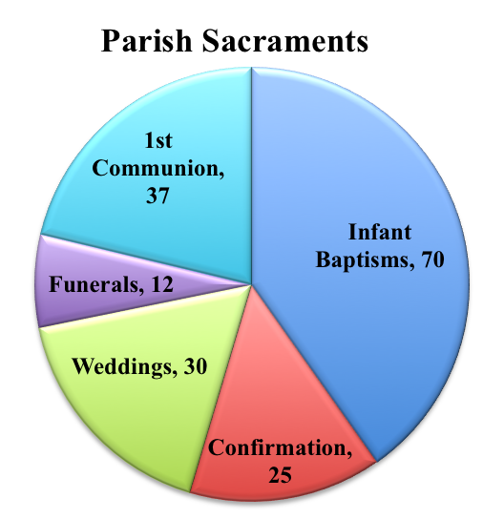
Dashboard Visuals – Pie Chart
Visually appealing display of data as a percentage of the whole
Each pie section is labeled

Slide 58
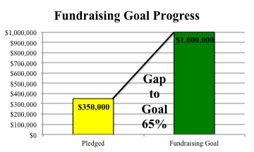
Dashboard Visuals – Gap to Goal Bars
Simple format to compare projected versus actual progress towards a goal.
Comparing bars one against the other can quickly show progress on the status of a financial goal.

Slide 59
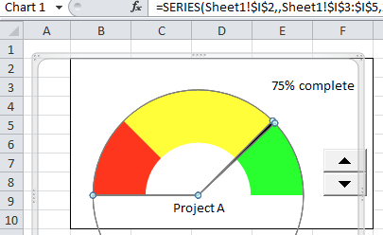
Dashboard Visual – Speed Gauge
A speed gauge visual can be used to indicate the extent to which progress is being made on a goal.

Slide 60

Financial Execution and Control
Michael Castrilli
mjcastrilli@gmail.com

Slide 61
Why can’t they leave me alone & just let me manage my budget

Slide 62

Financial Execution and Control
Focus on the overall health of the financial portfolio
Assess the cost, schedule, and progress toward achievement of outcome-based performance metrics
Consider emerging requirements due to new policies, staff changes, evolving Church developments

Slide 63

Execution and Control
Determine Process
Money management is both an art and science
  It takes creativity, time and practice
Determine Thresholds
Serious deviation versus minor short term problem
Analyze Data
  Variance Analysis
Remember – A snapshot in Time

Slide 64
Ideas When Reviewing a Variance Report
Understanding
  Ask questions, understand context, seek additional data and input.
Consider Order of Magnitude
Timing
  What period of time you are reviewing? Know when the report was generated so you can understand how to interpret the report. Quarterly? Monthly?
Develop Clear Rules of Engagement
  Promote transparency and expectations

Slide 65
Execution & Control Process (cont’d)
Determine time period when you will “check-in” on various elements of your budget.
  Right-size your control processes depending on the size of your organization
1s^{t} Quarter
Jan-March
2nd Quarter
April-June
3rd Quarter
July-Sept
4th Quarter
Oct-Dec
Variance Analysis
March 3, 2014
Variance Analysis #2
July 7, 2014
* Notional Example

Slide 66
Variance Analysis
Calculate the variance between actual and budgeted amounts for a given time period.
Determine time period - The period could be a year, a quarter, or six months
1 | 2 | 3 | 4 | 5
Category | $ Budgeted Amount (From Date to Date) | $ Actual Amount (AS OF DATE) | $ Variance Over/Under Budget = Budgeted – Actual | % Variance Over/Under Spent = (Variance / Budgeted) X 100
Enter Category | $00,000 | $00,000 | -$0,000 or $0,000 | - 00% or +00%

Slide 67
Variance Analysis Example
1 | 2 | 3 | 4 | 5
Category | $ Budgeted Amount (January – March 2014 ) | $ Actual Amount (April 1, 2014) | $ Variance Over/Under Budget = Budgeted – Actual | % Variance Over/Under Spent = (Variance / Budgeted) X 100
Office and Technology | $17,000 | $18,000 | -$1,000 | - 6%
Utilities | $12,000 | $12,250 | -$ 250 | -2%
Liturgical and Sacramental | $25,000 | $22,500 | $2,500 | 10%
Tips:
Note that variance is always a snapshot in time
Establish Process to evaluate results

Slide 68
Variance Analysis - Stoplight
1 | 4 | 5
Category | % Over/Under Spent | Analysis
Office and Technology | - 6% | - 6%
Utilities | - 2% | - 2%
Liturgical and Sacramental | 10% | 10%
Variance + or - Greater than 10%
Variance + or –Between 5%- 9%
Variance + or –
Less than 5%

Slide 69
Variance Analysis Status Reporting
Budget line items are scored against a "stoplight" rating scale and are assigned a red, yellow, or green rating
The ratings may be interpreted as follows:
  Red: Status information suggests that there may be significant issues that could impact the ability to deliver on budget
  Yellow: Status information suggests that there may be issues that, if not addressed immediately, could impact the ability to deliver the project on budget
  Green: The budget line item is progressing according to plan and there is no indication that the budget be over/under.

Slide 70

Analysis
Q = Question
U = Understand
E = Evaluate
S = Solve
T = Track

Slide 71

Course of Action Questions
What impact does this challenge have on the overall budget?
Which stakeholders need to be involved in the solution?
How quickly do we need to implement a solution (immediately, zero to three months, six months to one year, long term)?
What are the alternative options available to implement?
What are the risks to the success of the solution? How can we mitigate these risks?

Slide 72

Reprogramming/Reallocation
Adjustments of the budget through the movement of money from one category to another.
Cautions
Ensure proper alignment of funds
Make this a limited practice
Understand any rules and regulations for movement of money
Revisit movements

Slide 73

The 3-R Approach to Errors
Reflect on what has occurred. What is the actual data telling you about what happened?
Review reasons or circumstances that affected the forecast and to consider any changes that may be needed in how you project or estimate amounts in the future.
Refine any policies and procedures to mitigate the likelihood that the error will occur again.

Slide 74
Questions
For further questions or discussion, please do not hesitate to contact me at:
Michael Castrilli
mjcastrilli@gmail.com
(202) 262-7969

Slide 75
Appendix Slides

Slide 76

Analytical Tools:
Cost Benefit Analysis (CBA)
Michael Castrilli
mjcastrilli@gmail.com

