Slide 1
Leadership In Complex Pastoring Situations
A Call to Leadership
Archdiocese of Louisville – Priest Assembly
June 6, 2017
Mark Mogilka

Slide 2
Overview
Leadership & Vision for Parish Pastoring
Complex Pastoring
Unity In Diversity
Community Compatibility
Building Unity

Slide 3
Leadership
Leadership Is…,
The ability to
articulate a vision
AND
2. The ability to engage people
to make that vision a reality

Slide 4
Pastoral Leadership
What makes pastoral leadership different from leadership in general?
Answer: The leader and community together discern God’s Vision/Will and with God’s help, together make a commitment to do all they can do, to make God’s will/vision a reality.

Slide 5
Parish Basic Vision
A Parish is…,
1. A community, entrusted to
a pastor as shepherd
2. Place where faithful gather
for Eucharist
Where Christ’s saving
doctrine taught
4. Where charity, good works
are practiced
Catechism of the Catholic Church #2179
Encourages and trains evangelizers
Pope Frances – Evangelii Gaudium #28

Slide 6
Your Parish: The Body of Christ Alive in Our Midst
Family of Families
Lifelong Formation
Adults
Youth
Children
Charity & Social Justice

Slide 7
Typical Parish Structure
Pastor
Pastoral Council
Finance Council
Staff
Parish Committees
Parishioners

Slide 8
Changing Realities in Parish Life
1965 2017+
Catholic
Population
Parishes
Priests

Slide 9
CARA Research

Slide 10
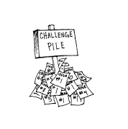
Complex Pastoring
Pastor has responsibility for two or more:
Parishes or missions
One parish with multiple church locations
Parish that is result of merger or consolidation of parishes
Multi-Cultural parish

Slide 11
Changing Complexity of Parishes
Traditional Parish 61%
Consolidated (since 2005) 7%
Multi-Parish Parishes 27%
Pastoral Life Coordinator 5%
Multicultural Parishes 38%
Regular mass other than English
Changing Face of US Parishes – 2011

Slide 12
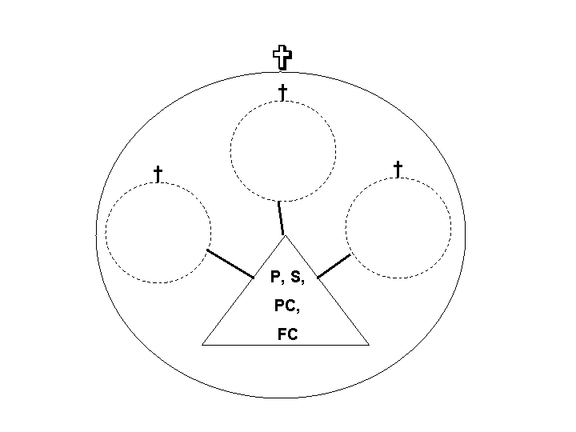
Models – Multiple Parish Pastoring/Ministry (The Mogilka Circles)
LL
LL

Slide 13
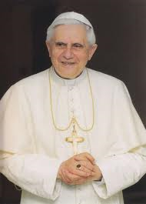
Multiple Parish Ministry
Q – How can priests/pastors handle growing responsibilities and multiple churches?
(Bishops) - “must see clearly
how to ensure that the parish
priest continues to be a pastor
and does not become a
holy bureaucrat.”
Pope Benedict XVI - Origins – 8/30/07 Vol. 37 #12

Slide 14
The Pastor
“Pastor as shepherd
carries out the duties
of teaching, sanctifying,
governing, with the
cooperation of other
presbyters or deacons
and the
assistance of lay members”
Canon 519

Slide 15
Maintenance – Management Leadership
“Mere administration can
no longer be enough.”
Throughout
the world let us be “permanently
in a state of mission”
Pope Francis – Evangelii Gaudium #25 cited from Aparecida

Slide 16
What Kinds of Leaders Needed?
Short Order Cooks?
Gourmet Chefs?

Slide 17
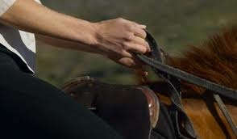
Pope Benedict XVI
“Furthermore, I think it very important to find the right ways to delegate…., (the priest) should be the one who holds the essential reins himself but can rely on collaborators.”
Meetings with Italian
Priests July 2007

Slide 18
The Church in America
“A renewed parish needs the collaboration of lay people and therefore a director of pastoral activity and a pastor who is able to work with others”
Saint John Paul II – Ecclesia in America 1999

Slide 19
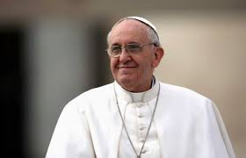
The Seven Last Words of the Church
“abandon the complacent
attitude that says
“we have always
done it this way”
Pope Francis – Evangelii Gaudium #33

Slide 20
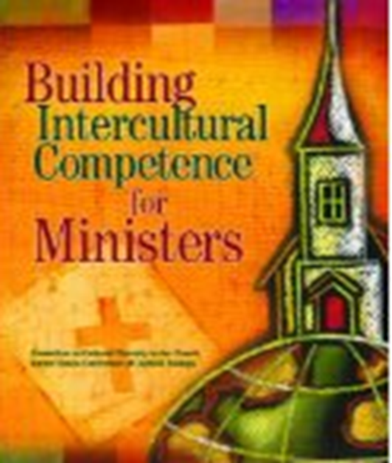
Complex Pastoring Vision – Question #1
Is it true that if you have the right leader – then just about any group can be brought together to create a new unity?
(Building Intercultural Competence for Ministers USCCB 2012)

Slide 21
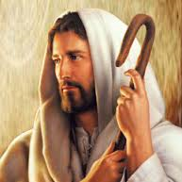
Dominant Ecclesiology – Unity
“so that they may all be
one, as you Father, are
in me and I in you, that
they also may be in us…,
so that they may be one
as we are one.” JN 17:22-23

Slide 22
Complex Pastoring Vision Question #2
Are there pastoral situations where the cultures of the groups that the pastor is called to serve, are so deeply rooted in their cultures, that it is unrealistic to expect to create a new unity in the near future?
(Best Practices for Shared Parishes - USCCB 2013)

Slide 23
Body of Christ
Second Ecclesiology:
“there are different kinds of spiritual gifts but the same spirit…, now the body is not a single part, but many”
1 COR 12 – 4, 14

Slide 24
Council of Jerusalem – 50 AD
“in Acts 15 neither the Jewish nor the Gentile Believers were asked to forsake their cultural uniqueness but were allowed to worship God in their own way, recognizing that God revealed himself differently to these diverse people”
Being the Church in a Multi-Ethnic Community – McIntosh & McMahan 2012

Slide 25
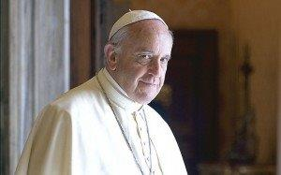
“We would not do
justice to the logic
of the Incarnation
if we thought of
Christianity as
monocultural and
monotonous”
Pope Francis – Evangelii Gaudium - #117

Slide 26
The Church in America
“there is a need keep looking for ways in which the parish and its pastoral structures can be more effective and efficient…, One way of renewing parishes…, might be to consider the parish as a community of communities and movements.”
Saint John Paul II – Ecclesia in America 1999

Slide 27
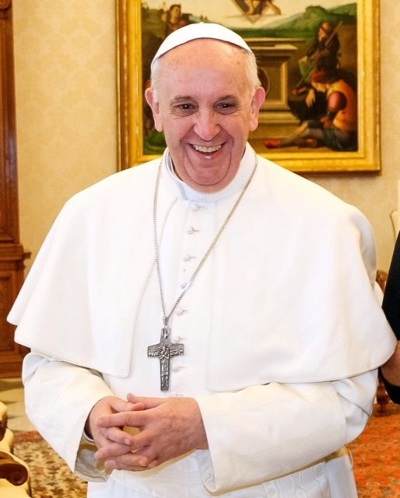
“In the church, variety,
which is itself a great
treasure, is always
grounded in the
harmony of unity
like a great mosaic.”
Pope Francis – Mass for presentation of the pallium to archbishops - June 29, 2013

Slide 28
Clarify Unity In Diversity
Unity does not mean uniformity
Involves Joyful recognition of various gifts of Holy Spirit
Unity needs differences
Do not be afraid of differences

Slide 29
Vision - Unity In Diversity
Unity
In Christ through the power
of the Holy Spirit
Diversity
Respecting and honoring
the unique aspects of each
culture and community
that make up the
Body of Christ

Slide 30
How do you know?
Work for Unity?
or
Separate – Shared Parish
or
Some Cooperation/
Collaboration

Slide 31
Parishioner Evaluations Traditional vs. MPM Parishes
1. Liturgies
2. Parish Vision
3. Stewardship
4. Faith Formation
5. Evangelizing
6. Preparation for Sacraments
7. Youth Ministry
8. Faith Formation – Kids
9. Faith Formation – Adults
10. Leadership of Pastor
11. Parish Involvement
12. Intercultural Ministry

Slide 32
Parish Compatibility Variables (Community Cultural Exegesis)
Ethnic
Ecclesial Identity
Relative Size
Economic Health
Geography
Relational History

Slide 33
Parishes (Communities) Compatibility Variables
Decision Making
Parish(Community) Priorities
Staff(s)
Parishioner Involvement
Tolerance for Change
Parish Viability
Other? – Telling the Community Stories

Slide 34
Can’t Force Community
Taken from the Leadership Journal – Winter 2014

Slide 35
Business – Mergers & Acquisitions Literature
What % of
business mergers
are successful?
50-80% FAIL
Why?
Lack of Employee Engagement
Failure to address cultural differences

Slide 36
Each Parish/Community Has a Unique Culture
“Culture primarily expresses how people live and perceive the world, one another, and God. Culture is the set of values by which a people judge, accept, and live what is considered important within the community”
USCCB, Ntl Plan for Hispanic Ministry (1988) 69
Respect it!

Slide 37
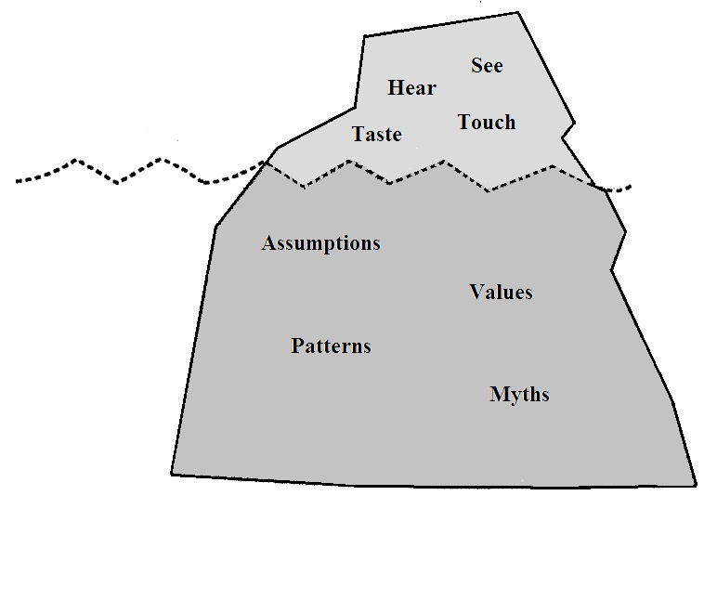
Iceberg Analogy of Organization Culture
External Culture
Explicit organization structure,
policies and decision-making process,
physical buildings, worship
Conscious
Easily changed
Objective Knowledge
Internal Culture
Implicit decision-making process,
assumed framework, informal leaders,
unarticulated beliefs and values
Unconscious
- Difficult to change
- Subjective Knowledge
⁴Eric H. F. Law, The World Shall Dwell with the Lamb (St. Louis: Chalice Press, 1993), pp. 4-10

Slide 38
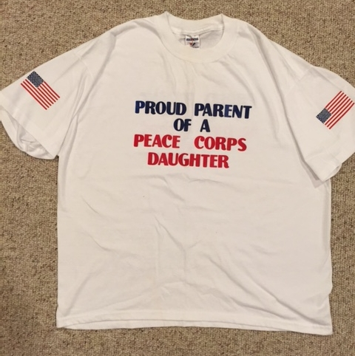
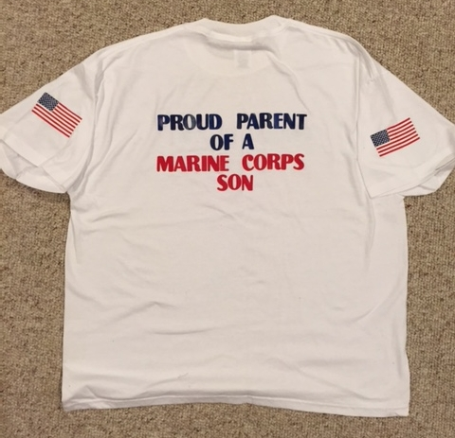
Parenting a Form of Complex Pastoring
Talk to Parents of Blended Families

Slide 39
An Observation
Change is Easy,
Transition
takes a lot more time
and patience

Slide 40
Stumbling Block to Unity
Announce it as your goal
Systems (Parishes) Naturally Resist Change
Will Circle the Wagons, Set Up Defenses
Draw Boundaries Tighter

Slide 41
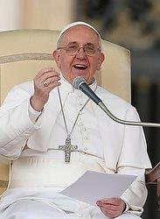
Communities Working Together?
“When leaders in various
fields ask me for advice, my
response is always the same:
dialogue, dialogue, dialogue”
Pope Francis – Address to Leaders in Brazil – July 27, 2013

Slide 42
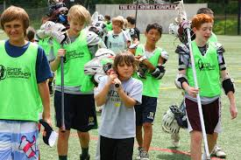
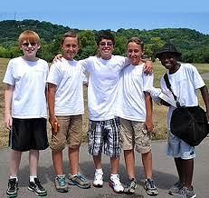
Unity - Social Psychology Summer Camp Study
Randomly assigned to groups
Formed strong identity bonds
Competition
Result – Mistrust Violence
Undo it?
Socials – No
Work Together – Yes!
Built Relationships
Pride in Accomplishment
Mazafer Sharif – Robbers Cave Experiment - 1961

Slide 43
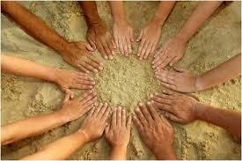
Building Unity?
To Build Unity –
Help Communities
learn to work
together
The by product is relationship building and in time, a new sense of identity and unity

Slide 44
Phases – Ministries, Programs & Services
Phase I – Each Parish – Separate
and Similar
Phase II – Some Centralized –
Some Site Specific
Phase III – All Centralized
Consider each site for something unique

Slide 45
Phases – Pastoral Councils
Phase I – Maintain existing councils
meet same night and place –
begin evening with common prayer and agenda
Phase II – Form Inter-parish pastoral council
Maintain existing councils – meet less often
Phase III – Form One Pastoral Council
Organize local “St. Mary Society”

Slide 46
Want Unity – Build Bridges
Shared Youth Group
Work on Mission Project/Trips
Community Service
Ministry Training/Formation
Christ Renews His Parish
Mixed Small Groups
Rotate Major
Celebrations
Other Ideas?

Slide 47
Best Practice - Branding
“The marketing practice of creating a name, symbol or design that identifies and differentiates a product from other products”
Mission Statement or Slogan

Slide 48
Best Practice – Random Acts of Kindness
“Evangelization Through Kindness”
Google It!
Randomactsofkindness.org
Kindspring.org
Acts10.org
Positive Sticky Notes
Clean Up Day
Laundromat Quarters
Be Kind to your Server Week
Amazon.smile
School Supplies
Flowers to Nursing Homes
Leave Inscribed Books

Slide 49
Best Practices – Technology
Use of Technology & Virtual Office Spaces
Overcome technophobia!
Explore ChMS – church management software
Parish(es) App
Accounting
Volunteer management
Supervision via SKYPE or Face Time
Virtual Meetings/Offices
Common Calendar
Extending Experience of Community via digital world

Slide 50
Key Questions
What is it that is unique and special in each community that must be acknowledged, honored, and respected.
What do we share in common that we can build on?
What is the best way to provide Pastoral Leadership to each individual Parish/Community?
What are the opportunities for building bridges of cooperation among the communities over time?

Slide 51
Wrap Up
Leadership & Vision for Parish Pastoring
Complex Pastoring
Unity In Diversity
Community Compatibility
Building Unity

Slide 52
Mark Mogilka
Senior Consultant
Meitler
“Smarter Decisions – Stronger Mission”
email: mmogilka@meitler.com
920-366-3988 (cell)
Complex Pastoring 6-6-17

